Slide 1


COVID-19 Induction for Volunteer’s, Staff & Anglers

Slide 2
Contents
COVID-19 Information and Public Health Advice
Important Contacts & Further Information
Procedures for Managing Risk in Returning to Work & Angling
ACI COVID-19 Response Plan
Suspected COVID-19 Case Management

Slide 3
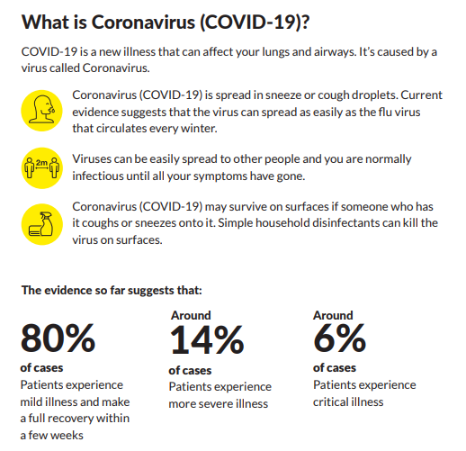
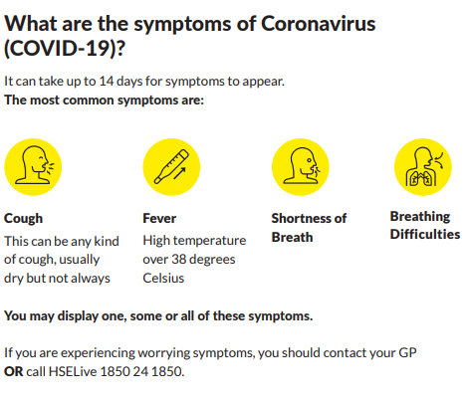
COVID-19 Public Health Advice

Slide 4
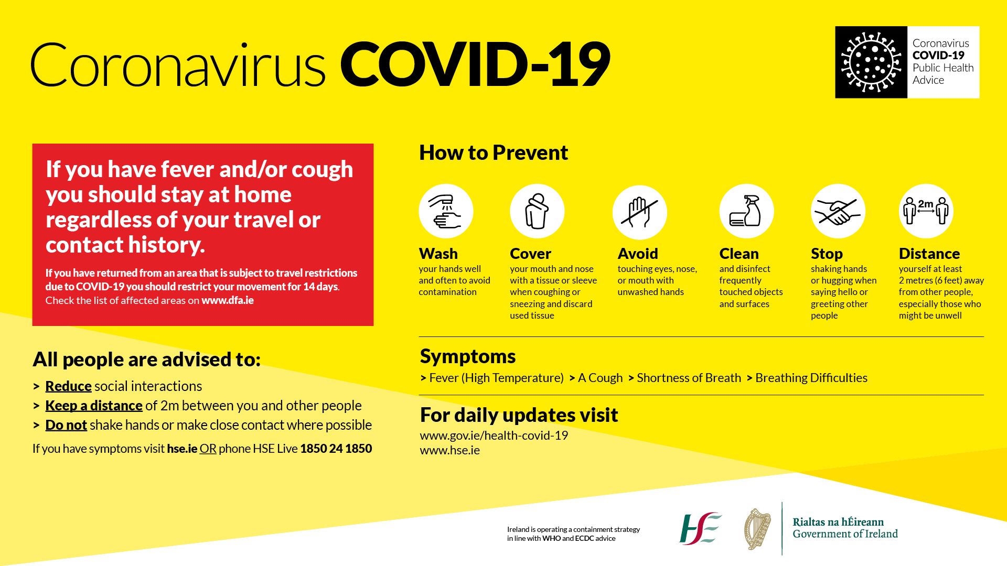
COVID-19 Prevention

Slide 5
ACI COVID-19 Response Plan
The ACI has a COVID-19 Response Plan which includes information about how COVID19 risk is being managed in the organisation. The plan includes the following:
Defence
Case Management
Recovery
The plan is informed by current public health advice and risk assessments in relation to COVID-19.
Essential measures contained in the plan are included in this training document, including control measures for preventing the spread of COVID-19 infection

Slide 6
COVID-19 Risk Control Measures
All employees have a responsibility under Health and Safety legislation to comply with measures to protect themselves and others.
In particular, social and physical distancing and good hand and respiratory hygiene are everyone’s responsibility

Slide 7

Risk Areas at Work and while Angling
High Traffic Areas such as canteen, toilets, lockers, printers, copiers, filing systems, wheelhouse, cabins.
Close working conditions
Use of shared equipment
Meetings
First Aid
Dealing with members of public
Travelling to and from work and angling venues
Access and exit points
Charter boats private boats

Slide 8
Control Measures at Work and while Angling
Compliance Officer and Worker / Angler Representative
Remote Working
Training and Communications
Pre-Return to Work / Angling Self Declaration(s)
Contact Log
Social and Physical Distancing
Hand Hygiene
Respiratory Hygiene/Cough Etiquette
Cleaning and sanitisation
Managing of Boats Welfare Facilities e.g. staggering breaks
Travelling To/From Work
Personal Protective Equipment (PPE)
Mental Health and Wellbeing Supports
Building & Charter Boat Management

Slide 9
Compliance Officer & Worker / Volunteer Representative
Compliance Officer and Worker Volunteer Representatives
COVID-19 Compliance Officers and Worker Representatives will be put in place throughout the organisation as appropriate. ACI HQ, SSTRAI, IFPAC, IFSA, IPS, EFSA, ICSA, and NIFFA
You will be notified of who the Compliance Officer(s) and Federation Volunteer Representative(s) are for your organisation or event location. There may be more than one Compliance Officer and Volunteer Representative to facilitate rostering and depending on factors such as nature of activity or work, location specific factors and volunteer/ coach/ numbers.
The Compliance Officer is responsible for
assisting in preventing the spread of COVID-19 at work or while angling by ensuring that protocols and control measures are implemented and adhered to.
Assisting in the case of a suspected or confirmed COVID-19 case at work or angling by informing ACI Executive or federation executive as appropriate and implementing the case management protocol
The Worker or Volunteer Representative is responsible for:
Supporting the implementation of COVID-19 control measures by monitoring control measures and compliance with same
Bringing volunteer or employee issues and concerns relating to COVID-19 prevention to the attention of the relevant NGB, Organisation or ACI Executive

Slide 10

Remote Working
Remote Working
  ACI’s policy is for all staff and volunteers who can work remotely (from home) to continue to do so for the foreseeable future and until further notice
  Attendance at the workplace will be permitted only on the basis of being absolutely essential and by prior arrangement with your ACI Secretary Jonathan Rice and following the protocol in place at the time.
  Examples of work for which you may need to attend at work at Sports HQ include:
    Essential cleaning and maintenance work to facilitate access for staff or volunteers and ensure the ongoing safety and maintenance of office space.
    Access to essential course materials or equipment for online coaching Coach Tutor and Exec members
    Access for collection of mail and essential operational or project work which is not possible to complete remotely

Slide 11
Training And Communications
Training:
All volunteers and staff are required to review the COVID-19 Training documents, and any information linked to prior to returning to the workplace or angling
You are required to confirm that you have completed the training prior to your return
Additional training material may be provided for certain groups of coaches as necessary, e.g. revised cleaning protocols
Communications:
All federations and organisations affiliated to ACI will ensure that communications are provided to volunteers and staff in relation to COVID-19 in relation to essential public health information, control measures etc.
Communication methods will include workplace or specific federation event signage, vessel on-board signage, e-mail, virtual meetings, training information, briefing documents etc. as required.

Slide 12
Pre-Return to Work or Angling Declarations
All staff / Volunteers returning to the workplace or organised angling events are required to complete a Pre-Return to Work/ Angling Self Declaration prior to being permitted to return to work or organised events.
This measure is required by the government protocol for Returning to Work Safely and is advisory for Organised Angling Events
This form requires employees /anglers to confirm that to the best of their knowledge, they have no symptoms of COVID-19 and that they are not self-isolating or awaiting the results of a COVID-19 test
These forms must be submitted to ACI Exec for Staff or you federation as requested, and will be forwarded to ACI and retained on you federation confidential file on a similar basis to other documents related to occupational health
Staff or ACI or federation event anglers who do not complete the declaration will not be permitted to return to work or organised angling events
At-risk or vulnerable volunteers /employees can inform their federation of this via the Self Declaration form and should engage with their federation in respect of establishing additional supports that may be required to protect their health.

Slide 13
Contact Logs
All staff returning to work or anglers returning to fish organised events will be required to complete and submit contact logs as per the Contact Log protocol in your federation or ACI
This requires you to identify who you have come in contact with during the course of your time in the workplace or organised event, whether in close contact, or sharing office, boat or space etc.
Contact logs are required as per government guidelines for the purpose of contact tracing in the event of COVID-19 case confirmation

Slide 14
Social and Physical Distancing:
All employees /volunteers/ anglers are required to maintain a distance of 2 metres between themselves and others at all times and to comply with the social and physical distancing measures implemented by you federation and ACI
Access to Sports HQ, and Coaching Ireland centres, and offices will be for ACI Executive staff only and will be rostered and scheduled to ensure that physical and social distancing is maintained at all times. Visitors and/or contractors will be by prior appointment only. No locations will be open to the public until further notice.
hygiene and distancing measures will be implemented in high traffic areas such as bathrooms, heads, kitchen/ wheelhouse, cabin, boat houses, areas surrounding printers and photocopiers etc. All volunteers /employees/ anglers are required to comply with all such measures. Boat Skippers will oversee arrangements for Charter Boats
Face to face meetings are to be avoided unless absolutely necessary and appropriate technology used for meetings. Where absolutely necessary, face to face meetings will take place in meeting rooms where seating will be assigned in line with social distancing. Volunteers/ employees are required to adhere to restrictions in meeting rooms and are not permitted to move seating etc.
Where teams are in attendance for essential work, movement around buildings, between floors and offices, on board vessels such as Charter Boats may be restricted to limit contact as much as possible

Slide 15
Social and Physical Distancing:
A no-handshake policy is in place and any close contact should be avoided. Employees should not share objects that touch their mouth, e.g. bottles or cups
Signage will be displayed in all locations
Screens will be implemented where necessary on the basis of a risk assessment, including at reception areas if required
Seating areas in canteens will be closed or restricted to designated seating only observing appropriate distancing

Slide 16
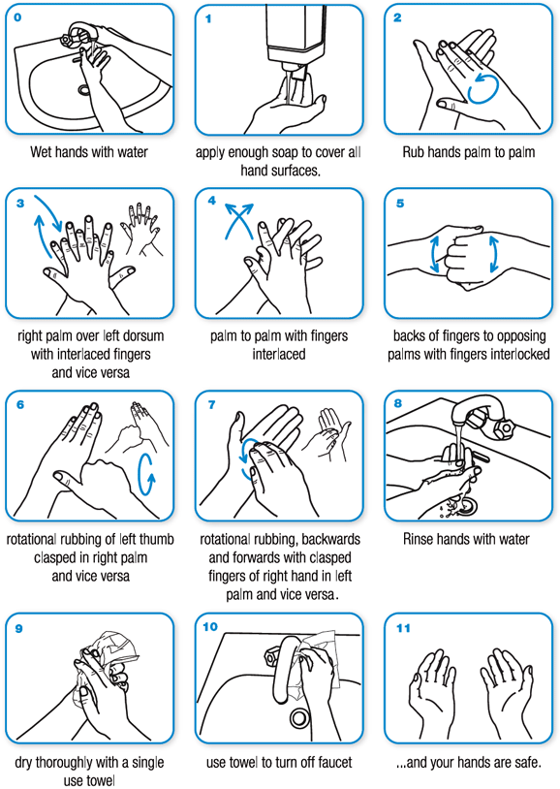
Hand Hygiene
Correct Hand Washing Technique
All volunteers/employees/anglers must comply with HSE Hand Hygiene advice including:
  Washing hands regularly and thoroughly
    After coughing or sneezing
    Before and after eating
    Before and after preparing food
    Before and after smoking or vaping
    Before and after being on public transport
    Before and after being in a crowd
    If in contact with someone who is displaying any COVID-19 symptoms
    When arriving and leaving the workplace or organised events
    After using the toilet
    Before and after using shared equipment or materials
    When caring for the sick
    When hands are visibly dirty
    You can use alcohol hand rub if hands are not visibly dirty
Please use correct handwashing
technique

Slide 17
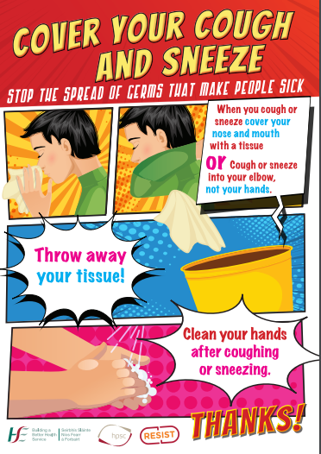
Cough Etiquette/Respiratory Hygiene
All volunteers /employees /anglers should comply with the following respiratory hygiene measures:
  Use a tissue to cover your mouth and nose when sneezing or coughing
  If you don’t have a tissue, cough or sneeze into your elbow
  Dispose of your tissue in the bin after use
  Wash your hands immediately

Slide 18
Cleaning and Sanitisation
All work and fishing areas will be cleaned at regular intervals using appropriate cleaning materials.
High contact points such as door handles, taps, toilets, bait tables, guard rails, rod holders, shared equipment and other touch points will be cleaned and disinfected frequently.
An ACI and Irish Chartered Skippers Association cleaning protocol is in place.
Hand sanitiser and appropriate cleaning supplies will be provided in all work and organised fishing event locations
Where necessary, volunteers, employees will be provided with disposable cleaning wipes to sanitise their work stations when in attendance at work or for fishing areas while fishing organised events.
A Clean work and fishing area policy will need to be strictly adhered to (or implemented if not already in place) in order to facilitate adequate cleaning and sanitisation

Slide 19
Welfare Facilities
Welfare facilities such as bathrooms, boat heads, tea stations, canteens, coach training breakout areas etc may pose high risk of infection due to high levels of staff contact and circulation.
The ACI’s policy is that welfare facilities in each location will be risk assessed and control measures put in place to minimise risk. Measures may include the following:
  Restriction or closure of seating areas
  Restrictions around use of shared facilities e.g. fridges, kettles, microwaves
  Introduction of disposable cups, plates etc.
  Use of clean disposable cups only to fill from water filters or taps
  Limitations on numbers permitted to use facilities at one time
All volunteers, staff, anglers must comply with restrictions put in place particularly on board vessels, angling huts, boat houses and respect arrangements such as revised use of spaces/designated seating in order to protect all volunteers, staff and anglers
If volunteers, staff or anglers have concerns in relation to measures implemented, or compliance with restrictions, these should be brought to the attention of the designated COVID-19 Compliance Officer or ACI executive.

Slide 20
Travelling To/From Work or Fishing Location:
All volunteers, employees, anglers should review their arrangements for travel to work or fishing destination in light of public health advice.
Volunteers, employees and anglers driving should not car pool unless absolutely necessary. If it is necessary to share a car, social distancing advice should be observed, i.e. only one other person should be in the car, sitting as far removed as possible
Volunteers, employees and anglers using public transport should observe the measures put in place by providers

Slide 21
Personal Protective Equipment
The ACI is monitoring closely the public health advice relating to the provision of Personal Protective Equipment (PPE)
ACI Sports HQ, member federations, affiliation organisations are assessing requirements for PPE and infrared forehead thermometer and ordering as required
Face masks are not currently recommended for general use, and will be provided where required following risk assessment i.e. small boats, e.g. for isolation of suspected cases, for cleaning after suspected cases, for First Aid delivery etc
Gloves are not currently recommended for general use and will be provided where required following risk assessment
If advice in relation to PPE changes, The ACI will update its risk assessments accordingly

Slide 22
Case Management Protocol for Suspected/Confirmed Cases of COVID-19
Each federation and organisation must have a designated person identified to deal with suspected or confirmed cases of COVID-19 should they arise.
The designated person will normally be a COVID-19 Compliance Officer, or boat skipper.
Volunteers /employees /anglers at organised angling events will be informed on a regular basis as to who the designated person is that day when they present for work.

Slide 23
Suspected Cases
Volunteers employees and anglers who experience COVID-19 symptoms should stay at home and seek appropriate medical advice
Under no circumstances should volunteers, employees, anglers or boat skippers /crew who exhibit COVID-19 symptoms attend at work or organised angling events
Volunteers, employees and anglers should contact ACI Executive or their federations through the designated person to inform them that they have COVID-19 symptoms and any advice they have received from their doctor or the HSE
Volunteers employees and anglers should keep their federation or designated person up to date in relation to any additional information or advice that is relevant i.e. if they are confirmed as having COVID-19 to facilitate necessary steps that may be required by ACI such as assisting the HSE with contact tracing.

Slide 24
Suspected Cases
If a volunteer, employee or angler becomes unwell at work or while participating in an organised angling event with COVID-19 symptoms the following protocol will apply.
The volunteer, employee or angler should immediately inform their line manager or the COVID-19 Compliance Officer
He/she will be taken to a designated isolation room area where practicable by the Compliance Officer (or outside if no room is available), maintaining a 2m distance from all other volunteers, staff and anglers at all times.
The employee will be provided with a mask and required to wear it (if one is available)
If possible, arrangements will be made for the volunteer, employee or angler to go home immediately and contact his/her doctor or the HSE for advice
If not possible, the volunteer, employee or angler will remain in the isolation room and arrangements made for him/her to contact their doctor or HSE or NHSNI for advice
While in isolation the volunteer, employee or anglers will be advised to cover his/her mouth and nose with tissues when coughing or sneezing and put the tissue in the waste bag provided. He/she will also be advised to avoid touching people, surfaces or objects.
Assistance will be provided to arrange transport home or to hospital. Public transport is not to be used in such cases
The Compliance Officer or Federation Designated Person will then:
Carry out an assessment of the incident and determine any follow up actions that may be required, including follow ups that may be required with contacts
Arrange for appropriate cleaning of the isolation area and work or angling areas involved
Provide assistance to the HSE or NHSNI if necessary

Slide 25
Confirmed Cases
If a confirmed case is identified in your home or work location, volunteers, staff or anglers who have had close contact will be asked to stay at home for 14 days from the last time they had contact with the confirmed case, and follow HSE / NHSNI advice
If a volunteer/employee or angler develops symptoms during this time, they should contact their doctor or hospital for advice as appropriate
Volunteers, staff or anglers who have had close contact with a confirmed case will include any individual who has had greater than 15 minutes face-to-face (<2metres distance) contact with a confirmed case in any setting
Contacts who have shared a space with a confirmed case for >2 hours may also be considered contacts, but this is subject to risk assessment taking into account the size of the room / area, ventilation and distance from the case
Contact tracing is dependent on the accuracy of contact logs and therefore volunteers, staff or anglers (during organised events) are required to adhere to the contact log procedure outlined in the previous section

Slide 26
Return to Work or Angling Following Suspected or Confirmed Case of COVID-19 OR Close Contact with a Confirmed Case
If you have had a suspected or confirmed case of COVID-19, or close contact with a confirmed case where you were advised to self-isolate, you must meet one of the below criteria before you will be permitted to return:
For close contact with a suspected or confirmed case:
A minimum of 14 days must have passed since last contact with a confirmed/suspected case with no symptoms
Where you have had a suspected or confirmed case of COVID-19:
A minimum of 14 days must have passed since the onset of symptoms, this must include a minimum of 5 days since last fever
You must provide a medical certificate advising that you are fit to return to work or organised angling event, where you have had a suspected or confirmed case of COVID-19. If it is not possible to obtain a medical certificate, you must complete and submit a self-declaration form.

Slide 27
Important Contacts
Your ACI Executive Member Bob Seward 0858436459, Federation or Organisation Coordinator will provide you with details of the COVID-19 Compliance Officer(s) and Volunteer / Worker Representatives for your work or organised angling activity location prior to your return.
You may contact the above if you have any concerns in relation to COVID-19 prevention measures

Slide 28
Further Information
You can find further information in relation to COVID-19 from the following sources:
Government of Ireland: https://www.gov.ie/en/campaigns/c36c85-covid-19-coronavirus/
Health Service Executive - https://www2.hse.ie/coronavirus/
Health and Safety Authority - https://www.hsa.ie/eng/topics/covid-19/covid-19_coronavirus.html
Health Protection Surveillance Centre - https://www.hpsc.ie/a-z/respiratory/coronavirus/novelcoronavirus/
Government UK https://www.nidirect.gov.uk/articles/coronavirus-recovery-plan

